Slide 1
6 school districts have gone on strike in the last 3 years. Is there any correlation?
A Data-Driven Investigation
Contributors: Emily Todd,
Prashant Ganorkar & Michelle Cascio

Slide 2

6 School districts
Measured against 6 variables
Denver
Detroit
Jersey City
Los Angeles
Oakland
Tacoma
% of English Language Learners
% of Students in Special Education
Student: Teacher Ratio
Per Pupil Funding
Source of Funding
State Test Scores
From Bureau of Labor Statistics

Slide 3
In-class Metrics Data Collection:
In-class Metrics
Issues:
NCES: National Center for Education Statistics
Searchable database called:
Elementary and Secondary Information System
Latest data reported is 2017
National average had to be calculated from the data given for each state.
Denver did not report data on % of IEPs.

Slide 4
DISTRICT Funding data collection:
DISTRICT Funding Issues:
Able to find data on funding per pupil
NCES: National Center for Education Statistics
Searchable database called:
Elementary and Secondary Information System
Latest data reported is 2015
Detroit Public School District did not report

Slide 5
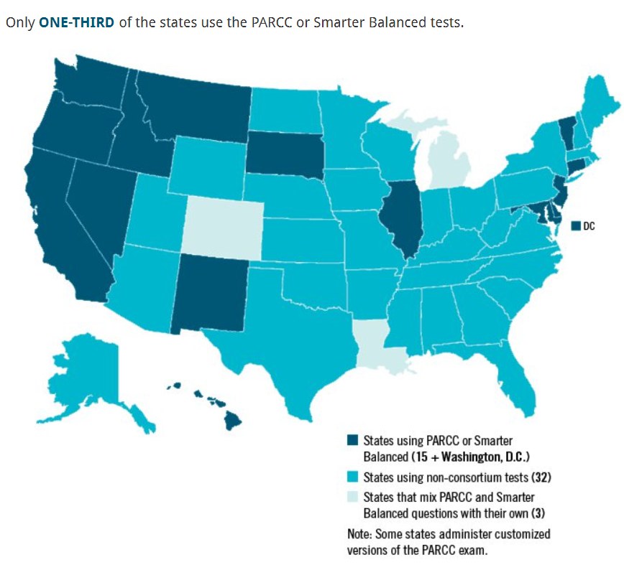
Test Data Issues:
States give different performance tests
National data is only offered for grades 4 and 8 every other year: 2015, 2017
Data is inconsistently per district (over the last 3 years)
Averages had to be manually aggregated in separate files for each district.

Slide 6
What testing measures are used in states where teachers have gone on strike (since 2015)?
School Year | Grade Level | CA | CO | MI | NJ | WA
2014-2015 | Grades 3-8 | SBAC | PARCC | MSTEP | PARCC | SBAC
 | High School | SBAC | PARCC | MSTEP | PARCC | SBAC
2015-2016 | Grades 3-8 | SBAC | PARCC | MSTEP | PARCC | SBAC
 | High School | SBAC | PARCC, PSAT, ACT | MSTEP | PARCC | SBAC (math), HSPE (ELA)
2016-2017 | Grades 3-8 | SBAC | PARCC | MSTEP | PARCC | SBAC
 | High School | SBAC | PARCC | MSTEP | PARCC | SBAC
2017-2018 | Grades 3-8 | SBAC | CMAS | MSTEP | PARCC | SBAC
 | High School | SBAC | PSAT, SAT | MSTEP | PARCC | SBAC

Slide 7








Slide 8
demo

Slide 9
Challenges Bringing the data Together
Create a consistent identifier (a primary key) for the 6 districts because there inherently provided across data sets.
den_co
det_mi
oak_ca
la_ca
jc_nj
taco_wa
Building visualizations from data that we couldn’t “see”.
Organizing our JSONified APIs in a way that we can call it as variables.

Slide 10
In-class metrics findings
STUDENT TO TEACHER RATIO
Student : Teacher ratio is very high in both Oakland (20:1) and Los Angeles (23:1).
Student : Teacher ratio is very low in Jersey City (12:1).
National Average is 16:1. The other three district ratios had a low variance to national average.
HIGH-NEEDS STUDENTS
Jersey City (9%) and Tacoma (9.6%) both have a smaller percentage of English Language Learners compared to the other 4 districts and the national average (12%).
Detroit (17%) has a higher percentage of Individualized Educations Plans (IEPs) compared to the other 5 districts (13 – 14%) and the national average (13.7%).

Slide 11
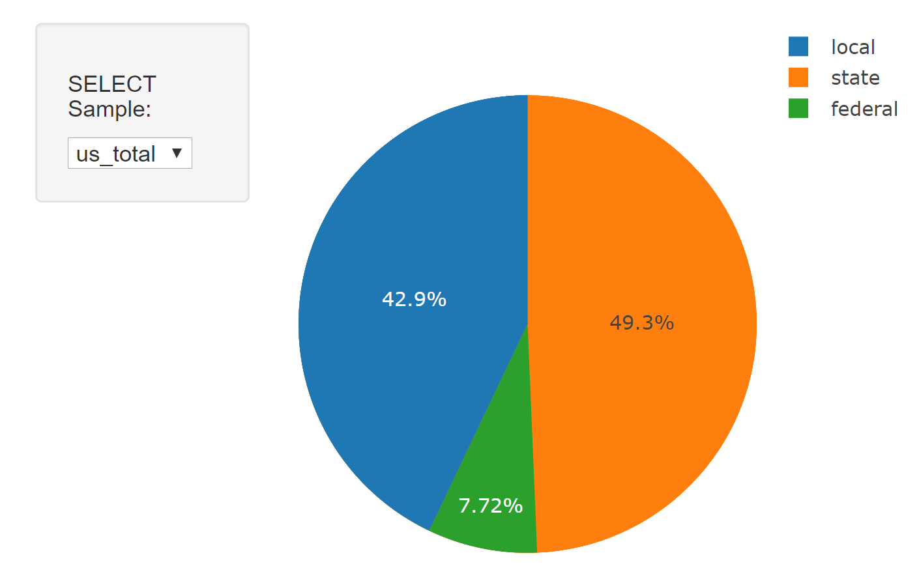
District Funding $
Funding sources:
~50% State, ~40% Local & ~10% Federal.
Exception: Jersey city(76%) & LA(62%) is from state
Comparison:
Five out of six districts funding/ pupil similar to national average of $13K
Jersey city gets double the national average
Spread:
Higher Std deviation comes from state funding (~$1700)
Jersey city, NJ seems to be an outlier.
Funding is significantly higher with low ELL
Why would NJ teacher strike?
May be funding is not proportional to teachers salaries?
Is higher % of ELL/Special education causes higher work load which contributes to teaches dissatisfaction?
Takeaways:
Districts which went on strike are funded close to or above the national average.
How funding is spent varies by district:
Higher funding does not imply higher salaries
Salaries seems to be a small portion of the funding based on teacher to student ratio
Are teachers striking due to low salaries and/or working conditions?
Stay tuned more to come – Final project

Slide 12
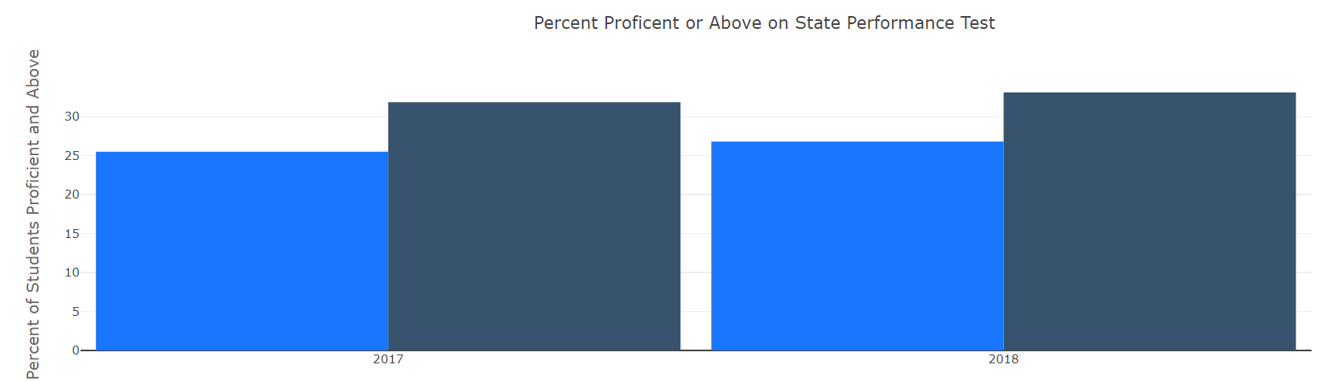
TEST SCORES findings
5 of the 6 districts are in states that have adopted the PARCC or SBAC. These tests are aligned to Common-Core standards (a rigorous set of national standards).
The percent of students from Denver Public School District who tested at proficient or above on state testing was far fewer than the national level.
District | English Language Arts (ELA) | Math
Denver | 39.2% | 39.5%
Detroit | 15.4% | 10.9%
Oakland | 32.5% | 26.2%
Jersey City | 44.2% | 29.6%
Los Angeles | 40.9% | 30.7%
Tacoma | 48.7% | 39.7%
(National) | 35% | 36%

Slide 13
Path Forward
Can we predict which school districts will strike next?

